Slide 1
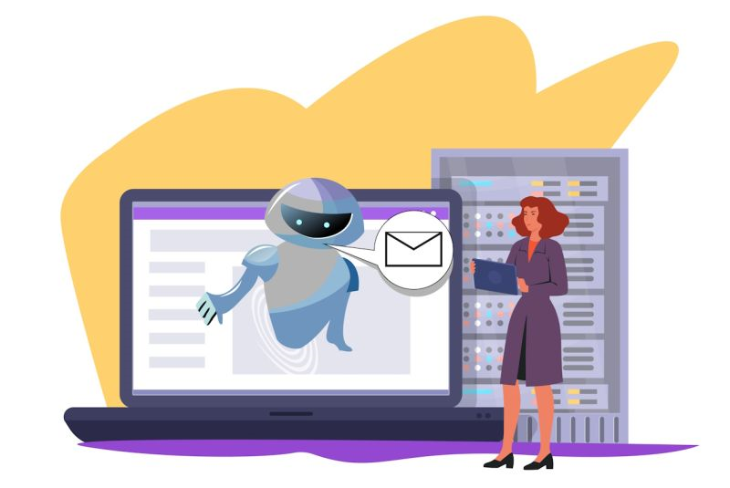
AI-Generated Phishing Detection System
M.Praveen
U23PG801CSC010
II-M.Sc Computer Science
Priyar University Centre for PG & Research Studies
Dharmapuri 6325 205
P. Sala
U24PG801CSC008
I-M.Sc Computer Science
Priyar University Centre for PG & Research Studies
Dharmapuri 6325 205

Slide 2

Introduction
Phishing Attacks:
A form of cyberattack where attackers impersonate legitimate entities to steal sensitive information (usernames, passwords, financial data).
These attacks target individuals and organizations, using email, social media, and websites as common vectors.
Phishing attacks are growing in both frequency and sophistication, leveraging social engineering tactics to deceive users.
Growing Prevalence in Cybersecurity:
With the increased digitalization of communication and online services, phishing attacks have become one of the most common cybersecurity threats.
According to recent studies, phishing is responsible for over 36% of data breaches globally, affecting both small and large-scale enterprises.

Slide 3
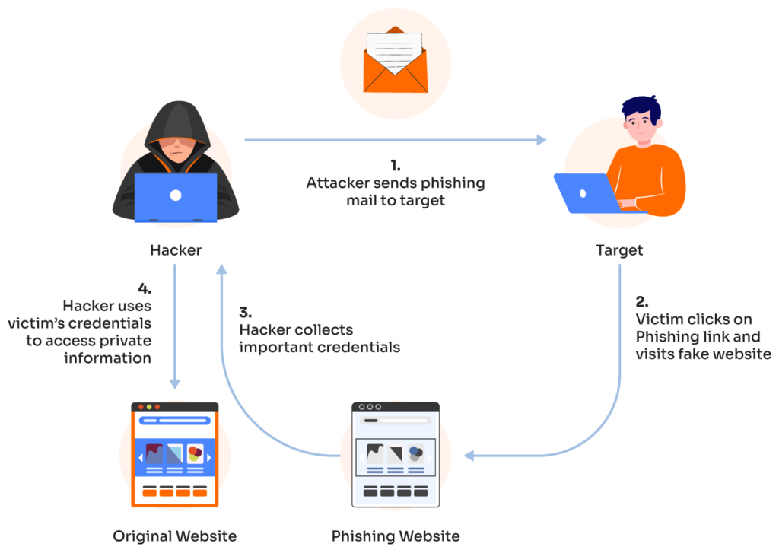
Challenges Faced by Traditional Phishing Detection Methods
Static Rules: Traditional detection systems rely on pre-defined rules or signatures, making them slow to adapt to new phishing techniques.
Easily Evasive: Attackers use simple tweaks (such as changing URLs or slightly modifying email formats) to bypass traditional filters.
Reactive Approach: These methods often react after the attack, leaving organizations vulnerable to newer, more complex phishing schemes.

Slide 4
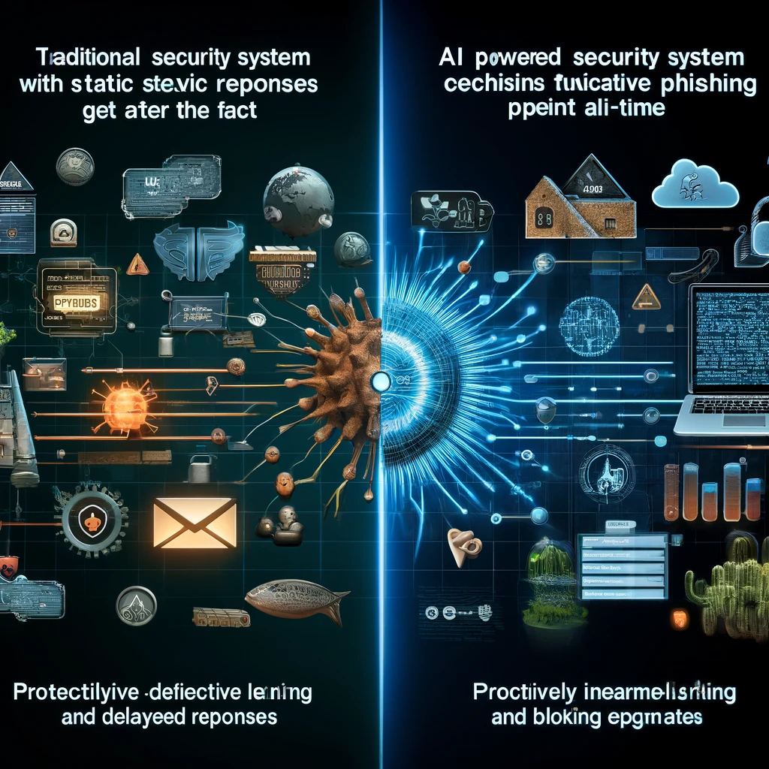
Role of AI
Proactive vs. Reactive Detection:
Traditional methods are reactive, identifying threats based on predefined rules after the fact.
AI-powered systems proactively detect phishing attempts by continuously learning and adapting to new data.
AI’s Adaptability:
AI systems can evolve with new phishing techniques, updating models to stay ahead of emerging threats.
This allows AI to defend against sophisticated attacks that exploit the static nature of traditional systems.

Slide 5
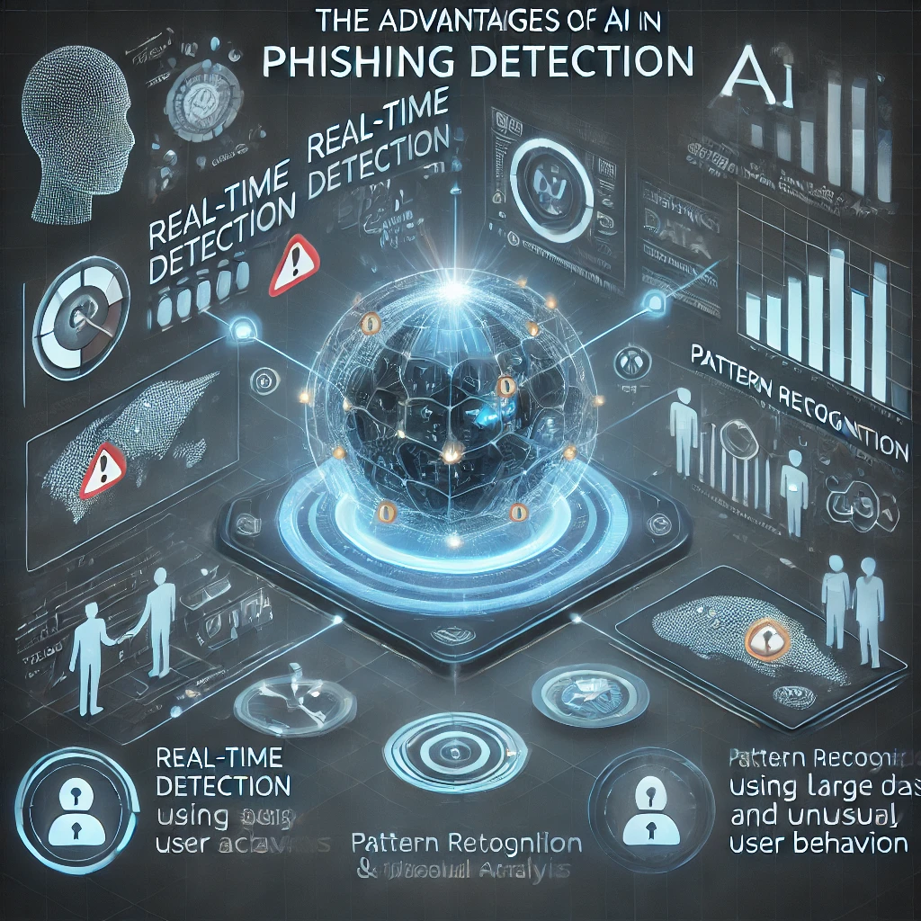
Advantages
Real-time Detection:
AI identifies phishing attacks as they occur, reducing response time and minimizing potential damage.
Pattern Recognition:
AI analyzes large datasets to identify patterns indicative of phishing, which may be missed by human analysis.
Behavioral Analysis:
AI monitors typical user behavior to spot anomalies, helping detect compromised accounts before they are misused.

Slide 6
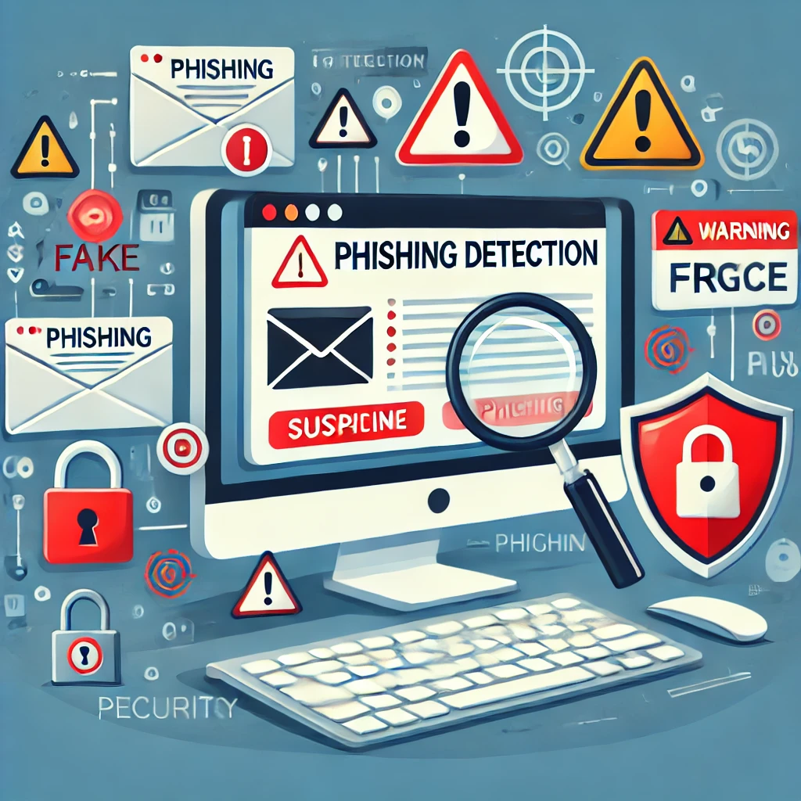
Traditional Phishing Detection
Methods:
Signature-based Systems:
Rely on known phishing signatures (patterns from previously identified phishing attempts).
Effective only for known threats, leaving organizations vulnerable to new variations.
Rule-based Systems:
Use pre-set rules (e.g., suspicious keywords or untrusted domains) to detect phishing attempts.
Rigid and often bypassed by small modifications in phishing tactics.

Slide 7
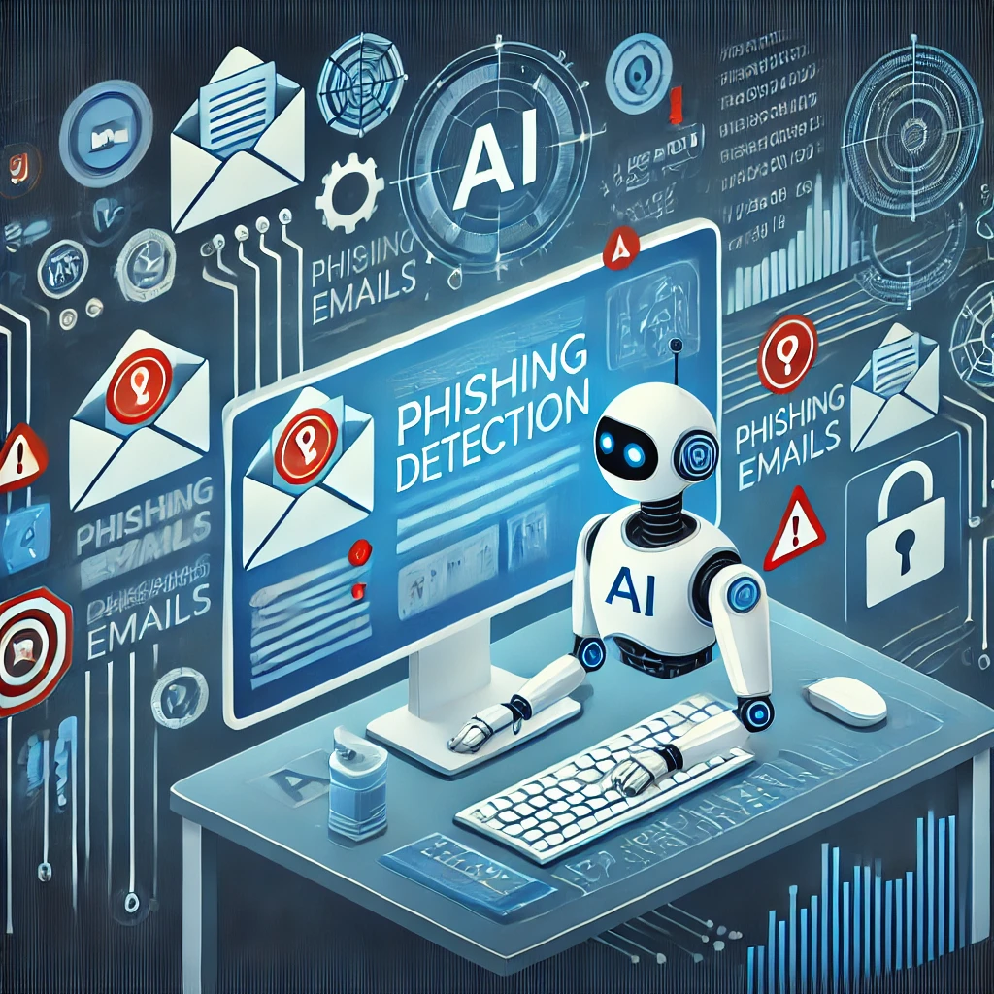
AI Techniques for Phishing Detection
Machine Learning Models:
Supervised Learning:
Models like decision trees, random forests, and support vector machines (SVMs) are trained on labeled datasets.
These models classify emails as phishing or legitimate based on predefined features.
Unsupervised Learning:
Detects anomalies by identifying emails or behaviors that deviate from normal patterns.
Useful for identifying unknown phishing techniques (zero-day attacks).

Slide 8
Challenges in AI Phishing Detection
False Positives:
AI systems sometimes misclassify legitimate emails as phishing attempts.
This can disrupt workflows and lead to user frustration.
Reducing false positives is crucial for improving the efficiency and trust in AI-driven systems.
Privacy Concerns:
AI requires large datasets for training, which may contain sensitive user information.
Ethical considerations must be made to ensure privacy and compliance with regulations (e.g., GDPR).
Balancing data use and protection is key to maintaining user trust.
Algorithmic Bias:
If training data lacks diversity, AI models may become biased.
This can result in the system overlooking certain types of phishing or disproportionately flagging benign emails.
Continuous evaluation and diversification of datasets are necessary to minimize bias.

Slide 9
Case Studies & Implementations
Financial Institutions:
Major banks and financial companies use AI-based systems to secure client communications.
These systems analyze patterns in email traffic and user behavior, significantly reducing successful phishing attacks.
Example: JPMorgan Chase has reported increased detection accuracy with AI tools, though challenges like false positives persist.
Enterprise Solutions:
Companies like Symantec have integrated AI into their cybersecurity platforms.
AI-powered systems detect real-time phishing attempts, reducing malware and ransomware incidents.
Symantec’s AI models continuously adapt to evolving threats, highlighting the importance of dynamic security measures.

Slide 10
Future Directions
Improving Accuracy:
Future improvements will focus on reducing both false positives and negatives by incorporating more diverse and high-quality training datasets.
Enhanced models will improve detection precision, especially in identifying new, previously unseen phishing techniques.
Ethical Considerations:
With growing reliance on AI, there’s an increased need for transparency in AI systems.
Future regulations should ensure that AI usage in phishing detection respects data privacy and is transparent in how decisions are made.
Fostering user trust by adhering to ethical standards is critical.

Slide 11
Conclusion
AI has revolutionized phishing detection, offering real-time, adaptive, and efficient solutions compared to traditional methods.
Addressing challenges like false positives, data privacy, and algorithmic bias is critical to maximizing the potential of AI.
As AI systems continue to evolve, they will become indispensable tools in the fight against phishing and other cybersecurity threats.

Slide 12
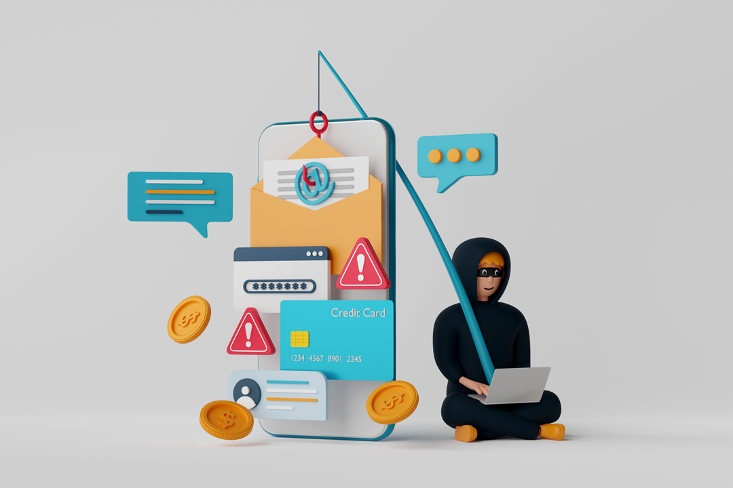
Q&A ?

